Slide 1
What is Machine Learning
Machine learning is an application of artificial intelligence (AI) that provides systems the ability to automatically learn and improve from experience without being explicitly programmed.
Machine learning focuses on the development of computer programs that can access data and use it learn for themselves.
The process of learning begins with observations or data, such as examples, direct experience, or instruction, in order to look for patterns in data and make better decisions in the future based on the examples that we provide.
The primary aim is to allow the computers learn automatically without human intervention or assistance and adjust actions accordingly.

Slide 2
Some machine learning methods
Machine learning algorithms are often categorized as supervised or unsupervised.
Broadly, there are 3 types of Machine Learning Algorithms.
1. Supervised Learning
This algorithm consist of a target / outcome variable (or dependent variable) which is to be predicted from a given set of predictors (independent variables).
Using these set of variables, we generate a function that map inputs to desired outputs.
The training process continues until the model achieves a desired level of accuracy on the training data.
Examples of Supervised Learning: Regression, Decision Tree, KNN, Logistic Regression, Random Forest, etc.

Slide 3
Some machine learning methods
2. Unsupervised Learning
In this algorithm, we do not have any target or outcome variable to predict / estimate.
It is used for clustering population in different groups, which is widely used for segmenting customers in different groups for specific intervention.
Examples of Unsupervised Learning: K-means, Apriori algorithm
3. Reinforcement Learning:
Using this algorithm, the machine is trained to make specific decisions.
It works this way:
The machine is exposed to an environment where it trains itself continually using trial and error.
This machine learns from past experience and tries to capture the best possible knowledge to make accurate business decisions.
Example of Reinforcement Learning: Markov Decision Process

Slide 4
List of Common Machine Learning Algorithms
Here is the list of commonly used machine learning algorithms. These algorithms can be applied to almost any data problem:
Linear Regression
Logistic Regression
Decision Tree
SVM
Naive Bayes
kNN
K-Means
Random Forest
Dimensionality Reduction Algorithms

Slide 5
1. Linear Regression
It is used to predict
Stock Prices using input of news related to he stock, price window las month, social media follower’s activity, market position, peer performance last month.
Sales of a month
Airfare using factors like season, holiday, festival, no of seats occupied, min and max price of last year
Like/comment on social media
We establish relationship between independent and dependent variables by fitting a best line.
This best fit line is known as regression line and represented by a linear equation Y= a *X + b.
E.g Arrange students class by increasing order of weight, without asking them their weights.
You will visually analyze at the height and build of people and arrange them using a combination of these visible parameters.
This is linear regression in real life!

Slide 6
The person has actually figured out that height and build would be correlated to the weight by a relationship, which looks like the equation above. In this equation: Y – Dependent Variable, a – Slope, X – Independent variable, b – Intercept
These coefficients a and b are derived based on minimizing the sum of squared difference of distance between data points and regression line.
I.e. RSS= ∑(y[i]-(a*x[i]+b))^2 is minimized over a,b for best fit

Slide 7
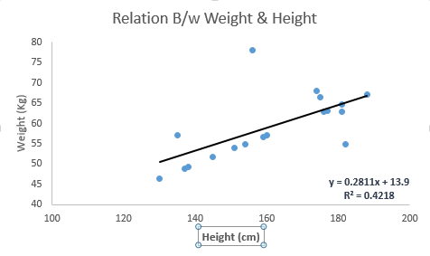
Look at the below example. Here we have identified the best fit line having linear equation y=0.2811x+13.9.
Now using this equation, we can find the weight, knowing the height of a person.

Slide 8
Linear Regression is of mainly two types: Simple Linear Regression and Multiple Linear Regression.
Simple Linear Regression is characterized by one independent variable.
And, Multiple Linear Regression(as the name suggests) is characterized by multiple (more than 1) independent variables.
y=⅀(a[i]*x[i]), x[i] are various parameters
While finding best fit line, you can fit a polynomial or curvilinear regression.
Here RSS= ∑(y[i]-(a[1]*x[1][i]+a[2]*x[2][i]+......a[d]*x[d][i]))^2 where d,n is the number of observations, and observations
And these are known as polynomial or curvilinear regression.

Slide 9
2. Logistic Regression
It is used to estimate discrete values ( Binary values like 0/1, yes/no, true/false ) based on given set of independent variable(s).
It predicts the probability of occurrence of an event by fitting data to a logit function.
Hence, it is also known as logit regression.
Since, it predicts the probability, its output values lies between 0 and 1 (as expected). Logistic function is also called sigmoid function.
The logistic regression formula is derived from the standard linear equation for a straight line that is y=mx + b .
Using the Sigmoid function (shown below), the standard linear formula is transformed to the logistic regression formula (also shown below).
This logistic regression function is useful for predicting the class of a binomial target feature.

Slide 10
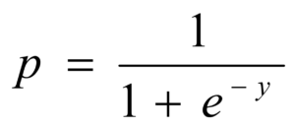
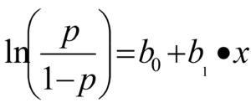
2. Logistic Regression
i.e.
Logistic Regression Assumptions
The important assumptions of the logistic regression model include:
Target variable is binary
Predictive features are interval (continuous) or categorical
Features are independent of one another
Sample size is adequate – Rule of thumb: 50 records per predictor

Slide 11
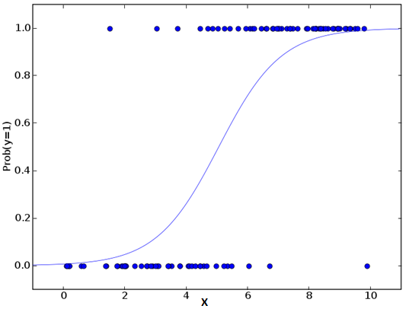
For large negative values and large positive values, the value returned is near zero and near 1 respectively.

Slide 12
Uses for Logistic Regression
A few things you can do with logistic regression include:
You can use logistic regression to predict whether a customer will convert (READ: buy or sign-up) to an offer. (will not convert – 0 / will convert – 1)
You can use logistic regression to predict and preempt customer churn. (will not drop service – 0 / will drop service – 1)
You can use logistic regression in clinical testing to predict whether a new drug will cure the average patient. (will not cure – 0 / will cure -1)

Slide 13
Logistic Regression
Let’s say you are being given wide range of puzzles / quizzes in an attempt to understand which subjects you are good at.
The outcome to this study would be something like this – if you are given a trignometry based tenth grade problem, you are 70% likely to solve it. On the other hand, if it is grade fifth history question, the probability of getting an answer is only 30%.
This is what Logistic Regression provides you.

Slide 14
The log odds of the outcome is modeled as a linear combination of the predictor variables.
odds= p/ (1-p) = probability of event occurrence / probability of not event occurrence
ln(odds) = ln(p/(1-p))
logit(p) = ln(p/(1-p)) = b0+b1X1+b2X2+b3X3....+bkXk
Above, p is the probability of presence of the characteristic of interest.
It chooses parameters that maximize the likelihood of observing the sample values rather than that minimize the sum of squared errors (like in ordinary regression).

Slide 15
Decision Tree
It is a type of supervised learning algorithm that is mostly used for classification problems.
It works for both categorical and continuous dependent variables.
In this algorithm, we split the population into two or more homogeneous sets.
This is done based on most significant attributes/ independent variables to make as distinct groups as possible.

Slide 16
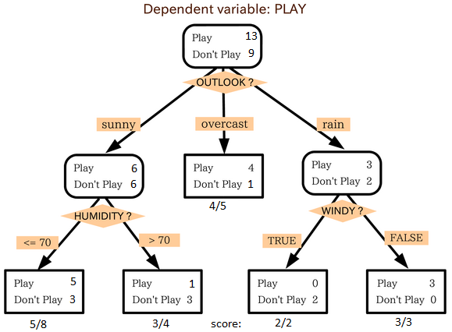
In the image below, population is classified into four different groups based on multiple attributes to identify ‘if they will play or not’.

Slide 17
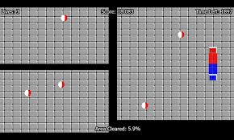
So, every time you split the room with a wall, you are trying to create 2 different populations with in the same room.
Decision trees work in very similar fashion by dividing a population in as different groups as possible.

Slide 18
4. SVM (Support Vector Machine)
It is a classification method.
In this algorithm, we plot each data item as a point in n-dimensional space (where n is number of features you have) with the value of each feature being the value of a particular coordinate.
For example, if we only had two features like Height and Hair length of an individual, we’d first plot these two variables in two dimensional space where each point has two co-ordinates.
These co-ordinates are known as Support Vectors

Slide 19
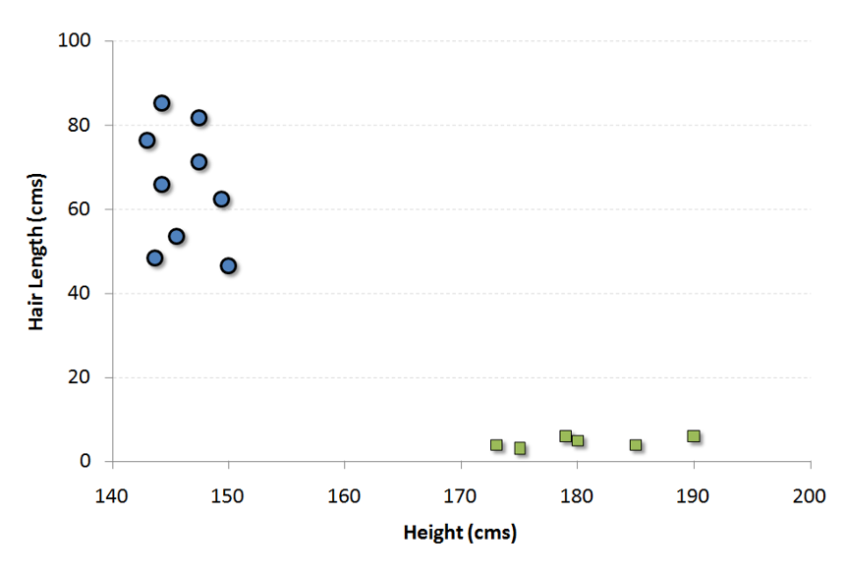
Now, we will find some line that splits the data between the two differently classified groups of data.
This will be the line such that the distances from the closest point in each of the two groups will be farthest away.

Slide 20
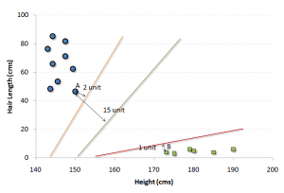
In the example shown above, the line which splits the data into two differently classified groups is the green line, since the two closest points are the farthest apart from the line. This line is our classifier.
Then, depending on where the testing data lands on either side of the line, that’s what class we can classify the new data as.

Slide 21
Think of this algorithm as playing JezzBall in n-dimensional space. The tweaks in the game are:
You can draw lines / planes at any angles (rather than just horizontal or vertical as in classic game)
The objective of the game is to segregate balls of different colors in different rooms.
And the balls are not moving.

Slide 22
SVM is a suitable classifier in following cases:
1) When number of features (variables) and number of training data is very large (say millions of features and millions of instances (data)).
2) When sparsity in the problem is very high, i.e., most of the features have zero value.
3) It is the best for document classification problems where sparsity is high and features/instances are also very high.
4) It also performs very well for problems like image classification, genes classsification, drug disambiguation etc. where number of features are high.

Slide 23
5. Naive Bayes
In simple terms, a Naive Bayes classifier assumes that the presence of a particular feature in a class is unrelated to the presence of any other feature.
For example, a fruit may be considered to be an apple if it is red, round, and about 3 inches in diameter. Even if these features depend on each other or upon the existence of the other features, a naive Bayes classifier would consider all of these properties to independently contribute to the probability that this fruit is an apple.
Naive Bayesian model is easy to build and particularly useful for very large data sets.
It is a classification technique based on Bayes’ theorem with an assumption of independence between predictors.
It is used in spam filtering, rating classification, sentiment detection,etc

Slide 24
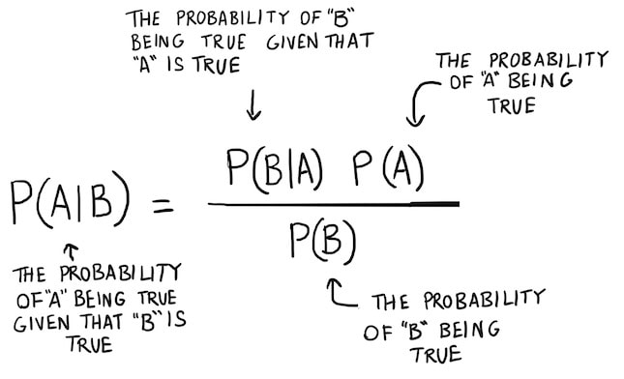
Bayes theorem:

Slide 25
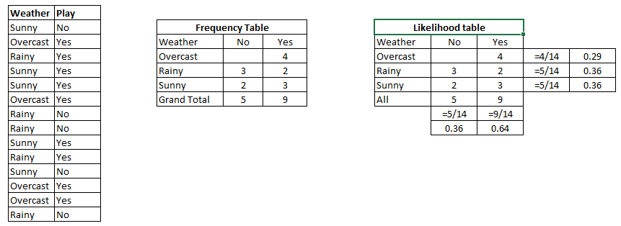
Example: Below I have a training data set of weather and corresponding target variable ‘Play’.
Now, we need to classify whether players will play or not based on weather condition.

Slide 26
Let’s follow the below steps to perform it. Step 1: Convert the data set to frequency table Step 2: Create Likelihood table by finding the probabilities like Overcast probability = 0.29 and probability of playing is 0.64.
Step 3: Now, use Naive Bayesian equation to calculate the posterior probability for each class.
The class with the highest posterior probability is the outcome of prediction.

Slide 27
Problem: Players will play if weather is sunny, is this statement is correct?
We can solve it using above discussed method,
so P(Yes | Sunny) = P( Sunny | Yes) * P(Yes) / P (Sunny)
Here we have P (Sunny |Yes) = 3/9 = 0.33, P(Sunny) = 5/14 = 0.36, P( Yes)= 9/14 = 0.64
Now, P (Yes | Sunny) = 0.33 * 0.64 / 0.36 = 0.60, which has higher probability.
Naive Bayes uses a similar method to predict the probability of different class based on various attributes.
This algorithm is mostly used in text classification and with problems having multiple classes.

Slide 28
6. kNN (k- Nearest Neighbors)
It can be used for both classification and regression problems.
However, it is more widely used in classification problems in the industry.
If K = 1, then the case is simply assigned to the class of its nearest neighbor.
K nearest neighbors is a simple algorithm that stores all available cases and classifies new cases by a majority vote of its k neighbors.
The case being assigned to the class is most common amongst its K nearest neighbors measured by a distance function.
KNN can easily be mapped to our real lives.

Slide 29
6. kNN (k- Nearest Neighbors)
If you want to learn about a person, of whom you have no information, you might like to find out about his close friends and the circles he moves in and gain access to his/her information!
KNN is used in a variety of applications such as economic forecasting, data compression and genetics.
For example, KNN was leveraged in a 2006 study of functional genomics for the assignment of genes based on their expression profiles.
Distance functions used can be Euclidean, Manhattan, Minkowski and Hamming distance.
First three functions are used for continuous function and fourth one (Hamming) for categorical variables.

Slide 30
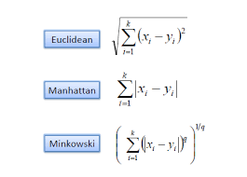
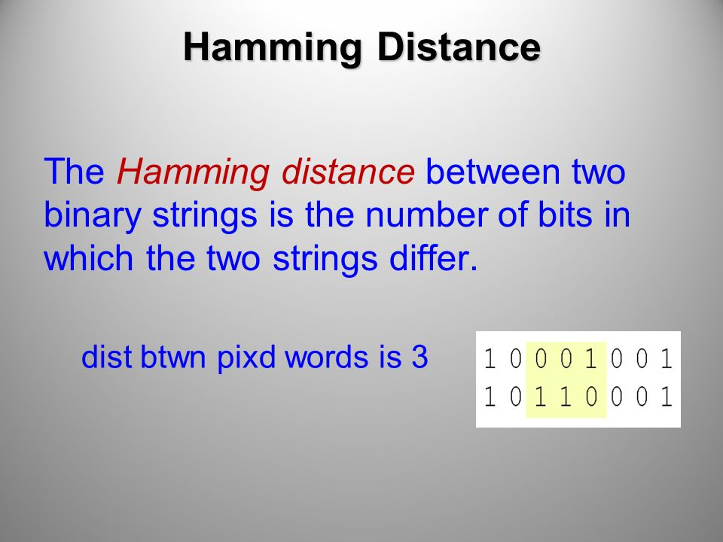
Various Distance Formulae

Slide 31
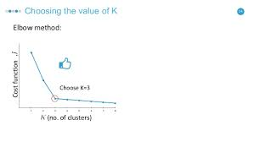
At times, choosing K turns out to be a challenge while performing kNN modeling. Elbow method is used and k is taken at the point where elbow bends

Slide 32
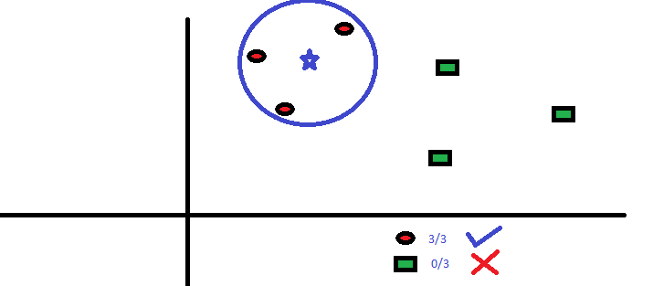
Things to consider before selecting kNN:
KNN is computationally expensive
Variables should be normalized else higher range variables can bias it
We can use weighting of neighbors in algorithm e.g. using inverse of distance from neighbor as multiplying factor

Slide 33
8. Random Forest
Random Forest is a trademark term for an ensemble of decision trees.
In Random Forest, we’ve collection of decision trees (so known as “Forest”).
To classify a new object based on attributes, each tree gives a classification and we say the tree “votes” for that class.
The forest chooses the classification having the most votes (over all the trees in the forest).
Each tree is planted & grown as follows:
If the number of cases in the training set is N, then sample of N cases is taken at random but with replacement. This sample will be the training set for growing the tree.
If there are M input variables, a number m<<M is specified such that at each node, m variables are selected at random out of the M and the best split on these m is used to split the node. The value of m is held constant during the forest growing.
Each tree is grown to the largest extent possible. There is no pruning.
It is one of the widely used technique in machine learning
In online machine learning competitions it is used broadly by winning teams

Slide 34
9. Dimensionality Reduction Algorithms
In the last 4-5 years, there has been an exponential increase in data capturing at every possible stages.
Corporates/ Government Agencies/ Research organisations are not only coming with new sources but also they are capturing data in great detail.
For example: E-commerce companies are capturing more details about customer like their demographics, web crawling history, what they like or dislike, purchase history, feedback and many others to give them personalized attention more than your nearest grocery shopkeeper.
As a data scientist, the data we are offered also consist of many features, this sounds good for building good robust model but there is a challenge.
How’d you identify highly significant variable(s) out 1000 or 2000?
In such cases, dimensionality reduction algorithm helps us along with various other algorithms like Decision Tree, Random Forest, PCA, Factor Analysis, Identify based on correlation matrix, missing value ratio and others.

